Slide 1
Contemporary Adolescence
Chapter 1
Adolescence in Social Context

Slide 2
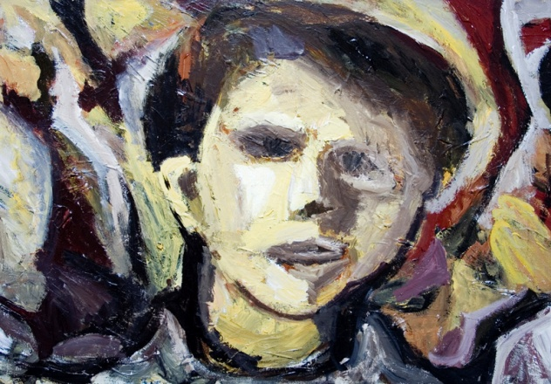
Adolescence History
Plato
How is the question of when young people are capable of reason still an issue in our time?
1500’s-1800’s
Life-cycle service
Turn of the (last) century
G Stanley Hall
Notes:
Plato believed that since children do not have the capacity of rational choices, formal education should not begin until 14. Children are seen similar to animals—impulsive and in pursuit of pleasure—sounds more like how we view adolescence today.
Life-Cycle service: late teens to early 20s would leave family and engage in labor or apprenticeship for 7 years. As cities grew bigger, even here in United States, it would attract teens and they became problematic for society—sex, drugs, and rock ‘n roll.
Turn of 20th century—”adolescence” finally used and area of research, child labor laws, requirement for secondary education
Is adolescence a time of “storm and stress”?

Slide 3
The beginning and end?
Childhood
Early Adolescence
Middle Adolescence
Late Adolescence
Emerging Adulthood

Slide 4
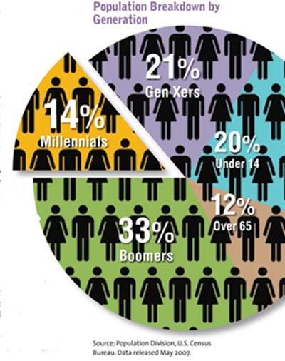
Generations—groups of adolescents
Baby Boomers
Born from mid 1940s until mid 1960s
Generation X
Adolescents in 1980s and 1990s
Generation Y
Born from about 1980 to 2000

Slide 5
Revolution I: Technology

Slide 6
Revolution I: Technology

Slide 7
Revolution I: Technology
1 in 4 adolescents has been subjected to unwanted sexual exposure on-line
1 in 5 adolescents has received a sexual solicitation (defined as a request for sex or sexual information)
3% reported an “aggressive solicitation” (defined as a suggestion for sexual contact by mail, phone, or in person)
(Finkelhor, Mitchell, & Wolak, 2000)

Slide 8
Revolution II: The Workplace
Working after school is associated with lowered school achievement and with increased delinquency and substance abuse rates
Working adolescents less likely to get adequate sleep and sufficient exercise

Slide 9
Revolution III: Education

Slide 10
Revolution IV: The Family
The Changing Functions of the Family
Function | Performing Institution, 1800 | Performing Institution, 2000
Educational | Family | School
Religious | Family | Church/Synagogue
Medical | Family | Medical profession
Economic Support | Family | Employer
Recreational | Family | Entertainment Industry
Affective | Family | Family

Slide 11
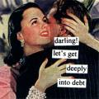
Revolution IV: The Family
The past 50 years have seen a rise in:
Divorce rates
Single parent households
Dual-earner families
Non marital cohabitation
Out of wedlock births

Slide 12
Revolution IV: The Family
Other trends:
Democratic family
Feminist movement
Child-centered families

Slide 13
Revolution V: Sexuality
Percentage of young men and young women who have engaged in premarital sexual relations
Country | Age | Men % | Women %
United States | 20 | 84 | 61
United Kingdom | 19-20 | 84 | 85
Germany | 20 | 78 | 83
Mexico | 15-19 | 44 | 13
Japan | 16-21 | 17 | 4

Slide 14
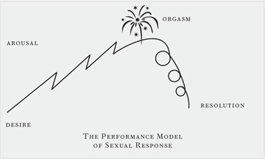
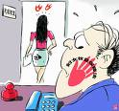
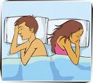
Revolution V: Sexuality
Positive effects of the sexual revolution
Scientific knowledge of sexual functioning
Treatment of sexual dysfunction
Contraceptives
Deal with unwanted sexual behavior

Slide 15
Revolution V: Sexuality
Negative effects of sexual revolution:
Earlier beginning to premarital sexual behavior
Nonmarital pregnancy
STDs
Confusion about sex

Slide 16
Revolution VI: Violence
Violent deaths
More than 75% of adolescents, 15-24, who die do so violently
Accidents
Suicides
Homicides

