Slide 1
Contemporary Adolescence
Chapter 2: Theoretical Context

Slide 2
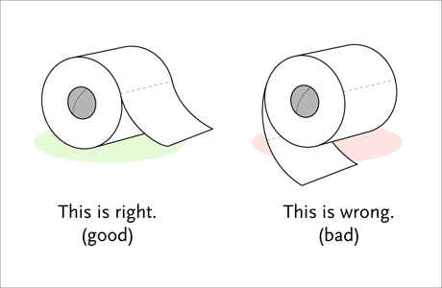
Beyond Piaget
Perry’s scheme of adult development
Stage 1: Dualism: there are right and wrong answers, the authority is the source of knowledge
Basic duality:
Full dualism:
Stage 2: Multiplicity: there are conflicting answers, therefore one must trust their inner voice
Early multiplicity: There are two kinds of problems:
Late multiplicity: We don’t know the answers to most problems, therefore, one’s opinion is fine. Or some problems are unsolvable, so it doesn’t matter which answer you choose.

Slide 3
Beyond Piaget
Perry’s scheme of adult development
Stage 3: Relativism: knowledge is relativistic and contextual, learners can think about thinking, authority is valued for its expertise, but not depended on exclusively
Contextual relativism:
“Pre-commitment”:

Slide 4
Beyond Piaget
Perry’s scheme of adult development
Stage 4: Commitment in relativism: making choices in the absence of clear or complete info, relativism demands individual choice and commitment, risk taking possible, wholehearted while tentative.
Commitment: making a commitment
Challenges to commitment: experiences implications of commitment, explores issues of responsibility
Commitment is ongoing, unfolding, evolving activity

Slide 5
Robert Selman
Before adolescence, children’s ability of perspective taking is limited
Stage 3, ages 10-12,
Mutual perspective taking
Stage 4
Social and conventional system perspective taking
Notes:
Text pg 34

Slide 6
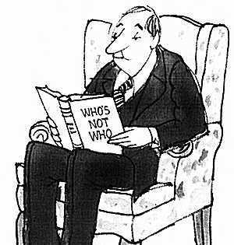
Robert Selman
Why is perspective taking important?
Perspective taking abilities is related to:
Popularity among peers;
Success at making new friends;
Awareness of actions on opinions of others;
Sympathy and pro-social behavior

Slide 7
Information processing
Attention
Selective
Divided
Memory
Short-term (including working memory)
Long-term
Speed and Automaticity
Notes:
Pages 69-73 in Arnett text
Selective: focus on something while ignoring others
Divided: Doing two things at the same time
Size of a person’s working memory is highly correlated with intelligence

Slide 8
Havinghurst: Developmental Tasks
Accepting one’s physique
New and more mature relationships with peers
Achieving masculine/feminine social sex role
Emotional independence from parents/adults
Prepare for an economic career
Prepare for marriage and family life
Desiring socially responsible behavior

Slide 9
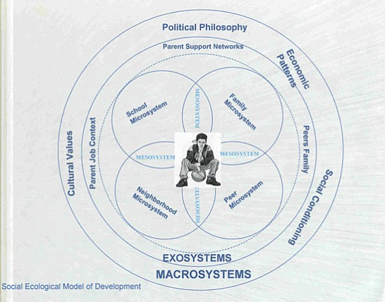
Bronfenbrenner: Ecological Model
Microsystem
Mesosystem
Exosystem
Macrosystem

Slide 10
Adolescent egocentrism
The imaginary audience
Personal fable

Slide 11
Critical Thinking
Adolescence provides potential for critical thinking:
Wider range of knowledge is available
Ability to consider different kinds of knowledge simultaneously
Metacognitive strategies are available for gaining or applying knowledge
Critical thinking skills do not develop automatically

Slide 12
Competent Decisions
Most studies comparing late adolescents and adults have found few differences between them in the decision making processes they use

Slide 13
Competent Decisions
Dual processing theory:
Analytic
Heuristic

