Slide 1
Contemporary Adolescence
Chapter 4
Body Issues

Slide 2
Sequence of Physical Changes
Boys
Characteristic | Age of first appearance
1. Growth of testes, scrotal sac | 9 ½ - 13 ½
2. Growth of pubic hair | 10 – 15
3. Growth spurt | 10 ½ - 16
4. Growth of penis | 10 ½ - 14 ½
5. Change in voice | 11 – 15
6. Spermarche | 12 – 14
7. Facial and underarm hair | 12 – 17
8. Oil and sweat production, acne | 12 - 17

Slide 3
Sequence of Physical Changes
Girls
1. Growth of pubic hair | 8 – 14
2. Growth of breasts | 8 – 13
3. Growth spurt | 9 ½ - 14 ½
4. Menarche | 10 – 16 ½
5. Underarm hair | 10 – 16
6. Oil and sweat production, acne | 10 - 16

Slide 4
Effects of Puberty on Parent/Child Relationship

Slide 5
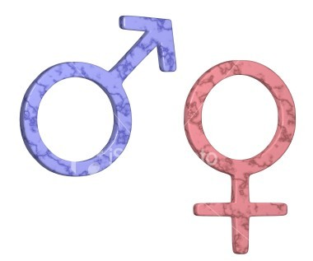
Gender
“During adolescence, the world expands for boys and contracts for girls. Boys enjoy new privileges reserved for men; girls endure new restrictions observed for women.”

Slide 6
History of Gender Development: Girls
Few occupational roles
Intellectual work was viewed as “unhealthy” for women
Viewed as incapable of strenuous work
Must keep young girls innocent

Slide 7
History of Gender Development: Girls
Physical appearance
In 1920s corsets were replaced by bras
In 1920s shaving legs and underarms became convention
Dieting also became conventional to maintain a boyish figure
In 1950s, boyishness was out and big breasts were in

Slide 8
History of Gender Development: Boys
Late 19th century many left family to “make it on their own”
Focus on strenuous activities
Learning self-control and self denial
In 20th century, anger and sexual desire was the manhood ideal

Slide 9
Gender Roles
Gender intensification hypothesis
Differential gender socialization

Slide 10
Problems with gender socialization
For girls, focus on physical appearance
For boys, aggressiveness
Solution: Androgyny?
Became popular in 1970s

Slide 11
Body Types and Ideals
Ectomorphs
Tall, long, thin, and narrow, with a slender, bony, lanky build
Endomorphs
Soft, round, thick, heavy trunks and limbs, and a wrestler-type build
Mesomorphs
In between the other two types

Slide 12
Quote
“I’m so tired of being fat! I’m going back to school weighing 119 pounds—I swear it. Three months in which to lose thirty pounds—but I’ll do it, or die in the attempt.”
--Excerpt from the diary of a 15 year old American girl in 1926

Slide 13
Body Image
Most Caucasian adolescent girls are dissatisfied with their bodies
This can affect the way they feel about themselves
Appearance anxiety in women is related to negative social experiences in childhood
Can vary based on culture

Slide 14
Body Image
Boys tend to prefer to have the mesomorphic body type
Adolescent males tend to feel better about their body as they get older

Slide 15
Weight
Obesity
Personal contributors to being overweight
Genetic
Motivation to eat
Eating patterns
Food preferences
Lack of exercise

Slide 16
Eating Disorders
Anorexia Nervosa
Bullimia

Slide 17
Nutrition
Many adolescents are deficient in:
Calcium
Iron, especially for young women
Protein
Vitamin A
Vitamin B6

